Slide 1
MetaPhlAn & HUMAnN
Thomas Coard

Slide 2
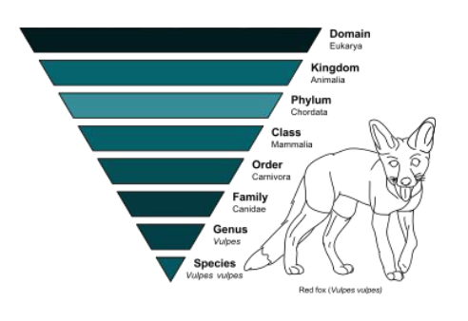
MetaPhlAn
MetaPhlAn is a program for determining the composition of microbial communities from metagenomic shotgun sequencing data.

Slide 3
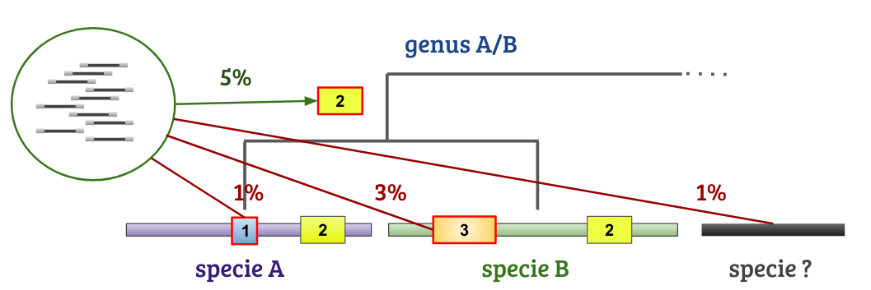
How it Works
MetaPhlAn looks for highly conserved clade-specific marker genes. Clades are groups of organisms that evolved from a common ancestor. A clad can be as specific as a species or as broad as a kingdom.
[3]

Slide 4
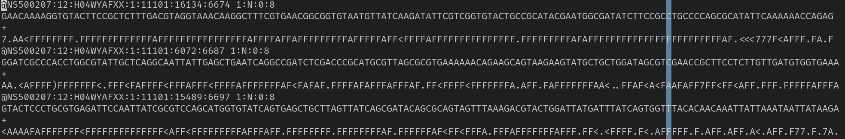
Input: 1-2 Fastq file(s)

Slide 5
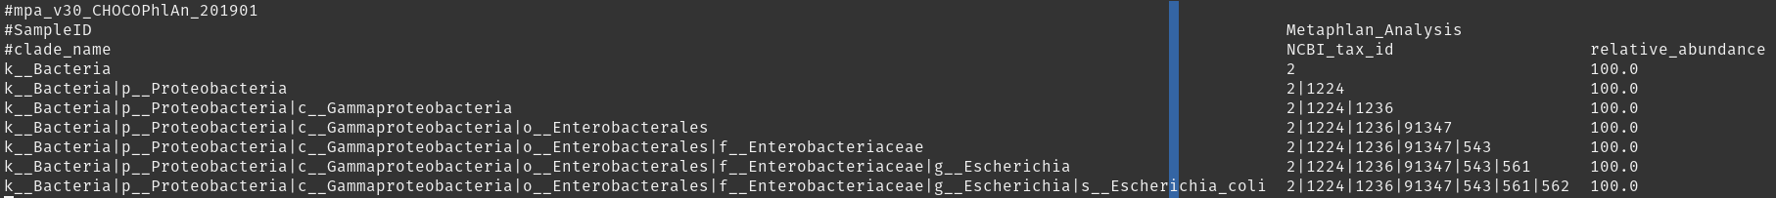
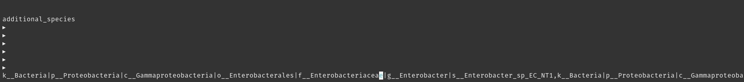
Output

Slide 6
HUMAnN
HMP Unified Metabolic Analysis Network.
HUMAnN is a method for efficiently and accurately profiling the abundance of microbial metabolic pathways and other molecular functions from metagenomic or metatranscriptomic sequencing data.

Slide 7
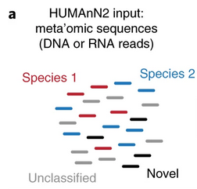
How it Works Pt. 1
HUMAnN2 rapidly identifies known microbial species in a sample by screening DNA or RNA reads with MetaPhlAn2
(Franzosa et al.)

Slide 8
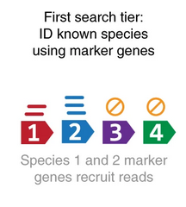
How it Works Pt. 2
HUMAnN2 then constructs a sample-specific database by merging preconstructed, functionally annotated pangenomes of the identified species
(Franzosa et al.)

Slide 9
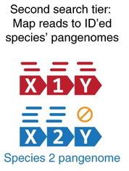
How it Works Pt. 3
In the second tier, HUMAnN2 performs nucleotide-level mapping of all sample reads against the sample’s pangenome database.
(Franzosa et al.)

Slide 10
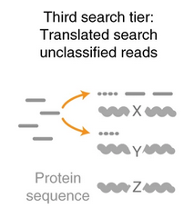
How it Works Pt. 4
In the third and final tier, reads that do not align to identified species’ pangenomes are subjected to accelerated translated search against a comprehensive protein database.
(Franzosa et al.)

Slide 11
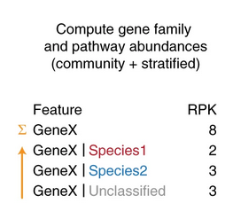
How it Works Pt. 5
Finally, gene families annotated to metabolic enzymes are further analyzed to reconstruct and quantify complete metabolic pathways in the community and per organism.
(Franzosa et al.)

Slide 12
Output
$OUTPUT_DIR/$SAMPLENAME_genefamilies.tsv
$OUTPUT_DIR/$SAMPLENAME_pathcoverage.tsv
$OUTPUT_DIR/$SAMPLENAME_pathabundance.tsv

Slide 13
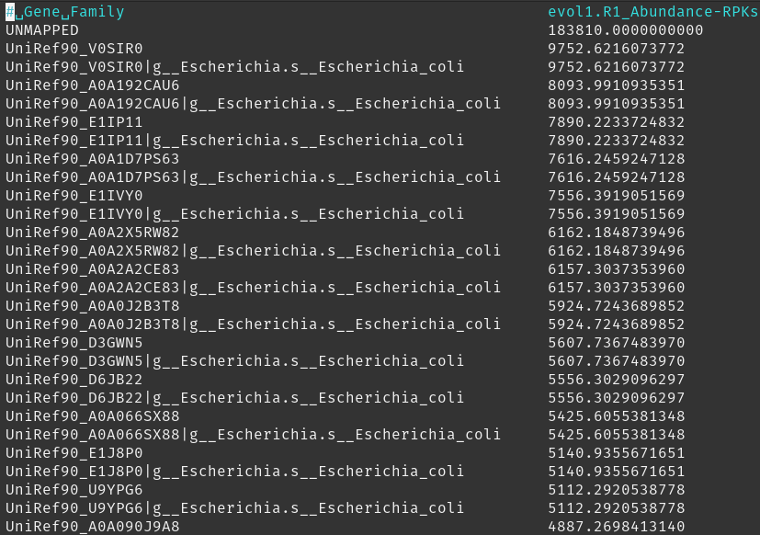
Gene Families
Gene family abundance is reported in RPK (reads per kilobase). This is computed as the sum of the scores for all alignments for a gene family. An alignment score is based on the number of matches to the reference gene for a specific sequence.

Slide 14
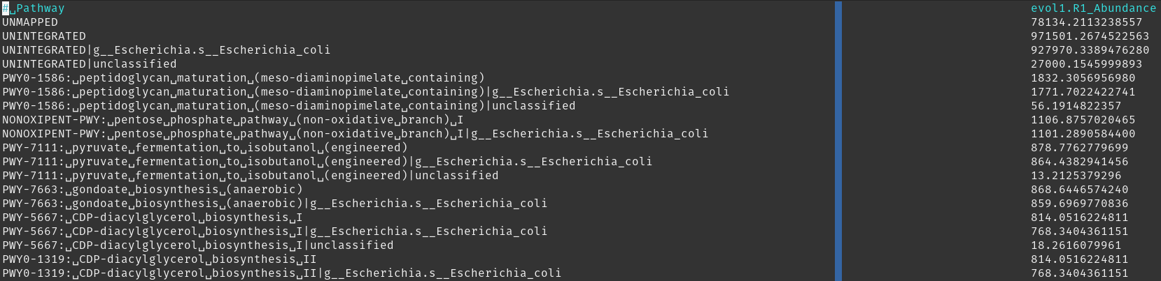
Path Abundance
“The abundance for each pathway is a recursive computation of abundances of sub-pathways with paths resolved to abundances based on the relationships and abundances of the reactions contained in each.” [1]

Slide 15
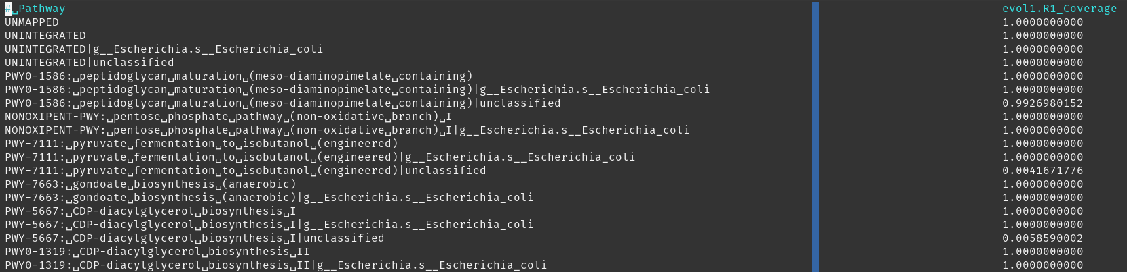
Path Coverage
Coverage is a confidence score assigned to each reaction detected in the community.

Slide 16
References
[1] https://github.com/biobakery/humann
[2] https://github.com/biobakery/MetaPhlAn
[3] http://borensteinlab.com/courses/TAU_CS_3116_B_19/presentations/7_MetaPhlan.pdf
Franzosa EA, McIver LJ, Rahnavard G, Thompson LR, Schirmer M, Weingart G, Schwarzberg
Lipson K, Knight R, Caporaso JG, Segata N, Huttenhower C. Species-level functional profiling of metagenomes and metatranscriptomes. Nat Methods 15: 962-968 (2018).
Francesco Beghini, Lauren J McIver, Aitor Blanco-Míguez, Leonard Dubois, Francesco Asnicar, Sagun
Maharjan, Ana Mailyan, Paolo Manghi, Matthias Scholz, Andrew Maltez Thomas, Mireia Valles-Colomer, George
Weingart, Yancong Zhang, Moreno Zolfo, Curtis Huttenhower, Eric A Franzosa, Nicola Segata. eLife (2021)

